Slide 1
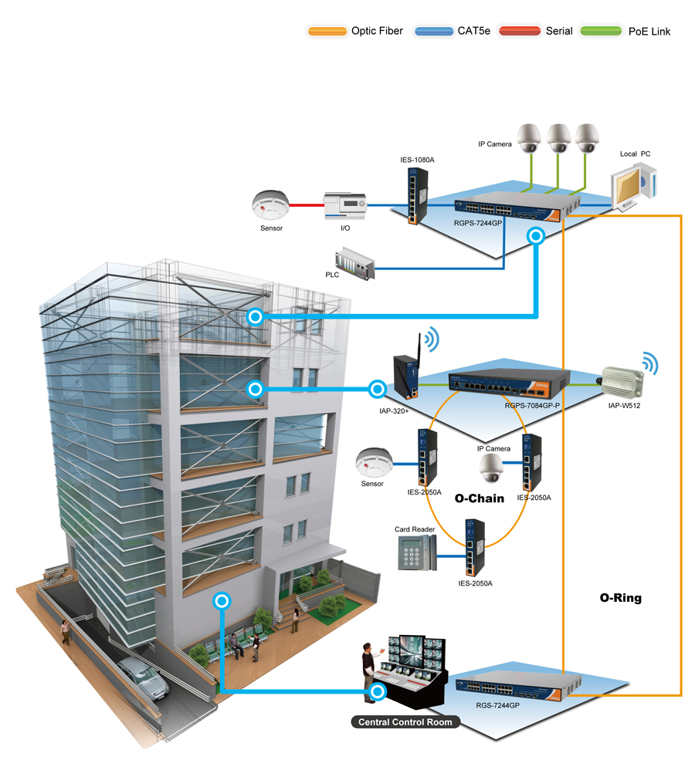
Network Design & Implementation
A Corporate IT Firm

Slide 2
Welcome To My Presentation

Slide 3
Supervisor
Mr. Muhammad Mahfuz Hasan
Course Co-ordinator & Chairperson ,
Department of Computer Science and Engineering and Assistant Professor
Department of CSE, Eastern University
Presented By
Md. Majharul Islam Patwary
Student ID : - 153400004

Slide 4
Content
Introduction
Background
Fundamental Design Goals
Existing Network System
Propose Network System
Objective
Network Layer
Our System Design Infrastructure
Required Tools

Slide 5
Introduction
We will make an internal networking system which consists of a Data Center two branch offices in Dhaka and Chittagong. Among these two branches and the data center, we want to make a strong wireless networking system. In each office will have, there will few specific organized departments.
Example:
    Admin/Managers office
    Accounting & Deployment Department
    Programming Department
    Development & Testing Department
    Technical Support Team
    Guest/Clients Waiting Room with free Wi-Fi etc.

Slide 6
Background
The motivation behind this project is based on some previous knowledge and experience in networking, network protocols, and configuration of Cisco network devices. What we hope to achieve at the end of the project is to improve our network design skills by doing research in that area and use the gathered knowledge for designing a network that will solve the problem.

Slide 7
Fundamental Design Goals
When we examined carefully, these requirements translate into four fundamental network design goals we have to follow.
  Scalability: Scalable network designs can grow to include new user groups and remote sites and can support new applications without impacting the level of service delivered to existing users.
  Availability: A network designed for availability is one that delivers consistent, reliable performance, 24 hours a day, 7 days a week. In addition, the failure of a single link or piece of equipment should not significantly impact network performance.
  Security: Security is a feature that must be designed into the network, not added on after the network is complete. Planning the location of security devices, filters, and firewall features is critical to safeguarding network resources.
  Manageability: No matter how good the initial network design is, the available network staff must be able to manage and support the network. A network that is too complex or difficult to maintain cannot function effectively and efficiently.

Slide 8

Existing Network System

Slide 9
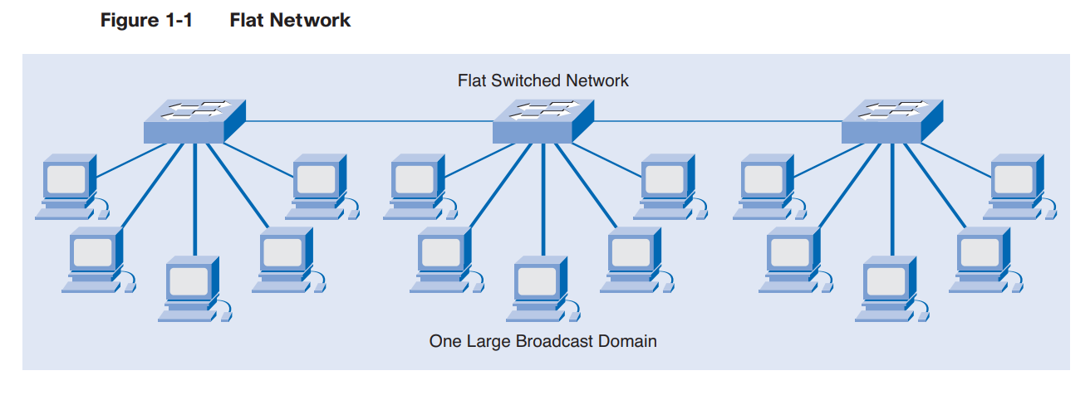
Flat networks are typically used in homes or small businesses where network requirements are low. Home networks usually do not require intensive security, or separation, because the network is often used to provide multiple computers access to the Internet.

Slide 10
Propose Network System
Hierarchical Network Design
Hierarchical network design provides efficient, fast and logical traffic forwarding patterns for enterprise network topologies while minimizing the cost of connecting multiple devices at network endpoints.

Slide 11
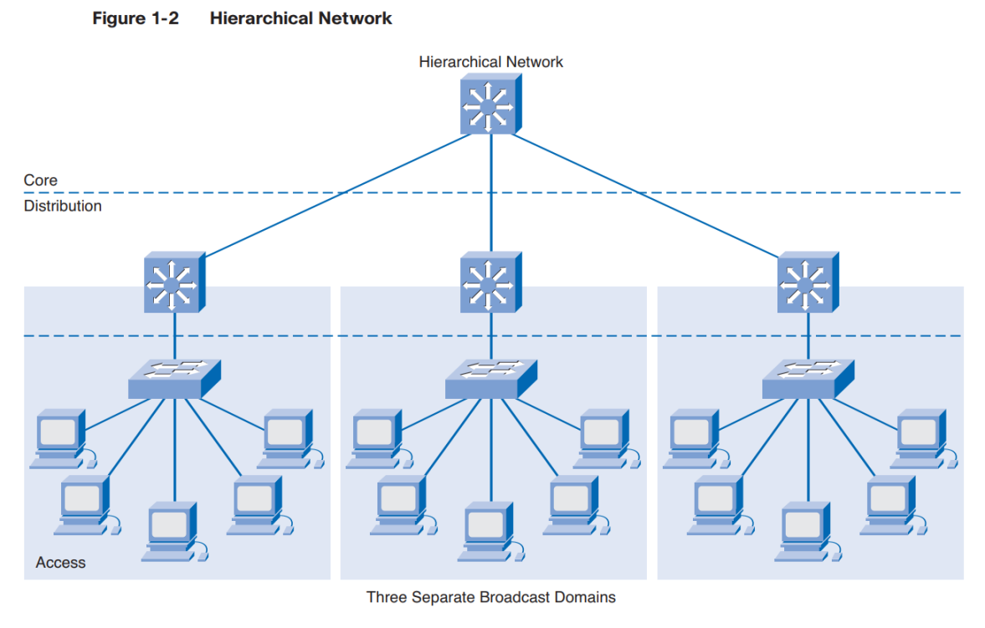

Slide 12
Objective
The final goal of this project is to show the design of a corporate computer communication network with a branched network of an affiliate. The requirements we have on our solution are that the branched network of affiliates could be regionally extended, international-extended with focus on the remote branch network implementation.

Slide 13
Network layer
The Hierarchical internetworking model is a three-layer model for network design first proposed by Cisco. It divides enterprise networks into three layers
Core layer: Connects distribution layer devices
Distribution layer: Interconnects the smaller local networks
Access layer: Provides connectivity for network hosts and end devices

Slide 14
Core Layer
The Cisco three-layer hierarchal model is composed of the core layer, distribution layer, and access layer. Of the three layers, the core layer is responsible for transporting large amounts of data quickly and reliably.
The core layer is sometimes called the network backbone. Routers and switches at the core layer provide high-speed connectivity. In an enterprise LAN, the core layer, shown in Figure, may connect multiple buildings or multiple sites, and may provide connectivity to the server farm. The core layer includes one or more links to the devices at the enterprise edge to support Internet, virtual private networks (VPN), extranet, and WAN access.

Slide 15
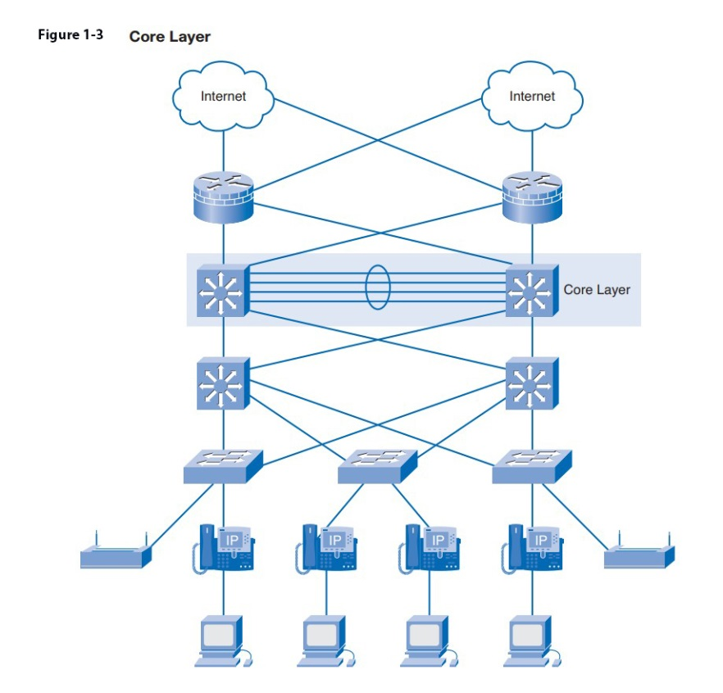
Implementing a core layer reduces the complexity of the network, making it easier to manage and troubleshoot.

Slide 16
Distribution Layer
The next layer of the Cisco hierarchical model is the distribution layer. This layer is associated with routing, filtering, and is the communication point between the core layer and the access layer. A network designer must create a distribution layer design that complements the needs of the other two layers.

Slide 17
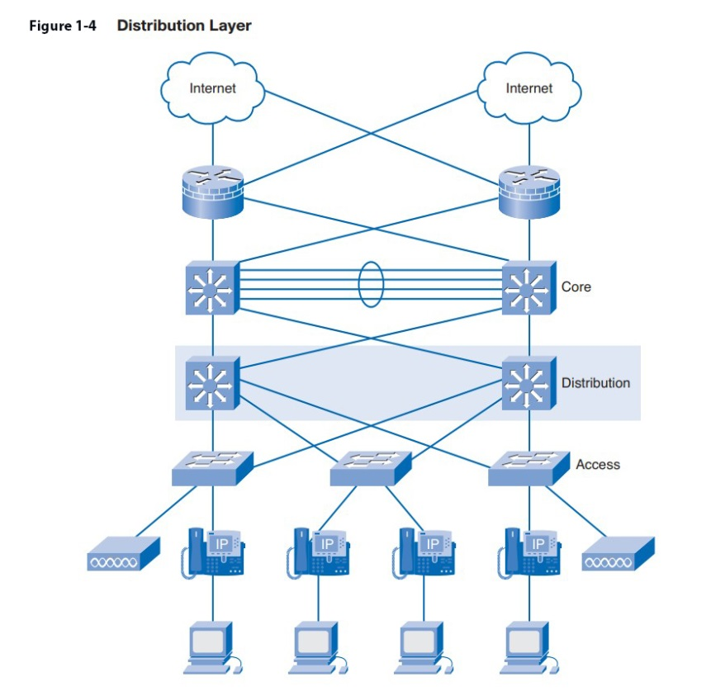
The distribution layer represents a routing boundary between the access layer and the core layer. It also serves as a connection point between remote sites and the core layer.

Slide 18
Access Layer
The access layer is used to control user access to the internetwork resources. The network designer has to facilitate the traffic generated from the access layer as it is bound for other segments or other layers within the network. Without an appropriate design, the access layer could quickly become inundated with traffic, resulting in less-than-acceptable performance for the end users.

Slide 19
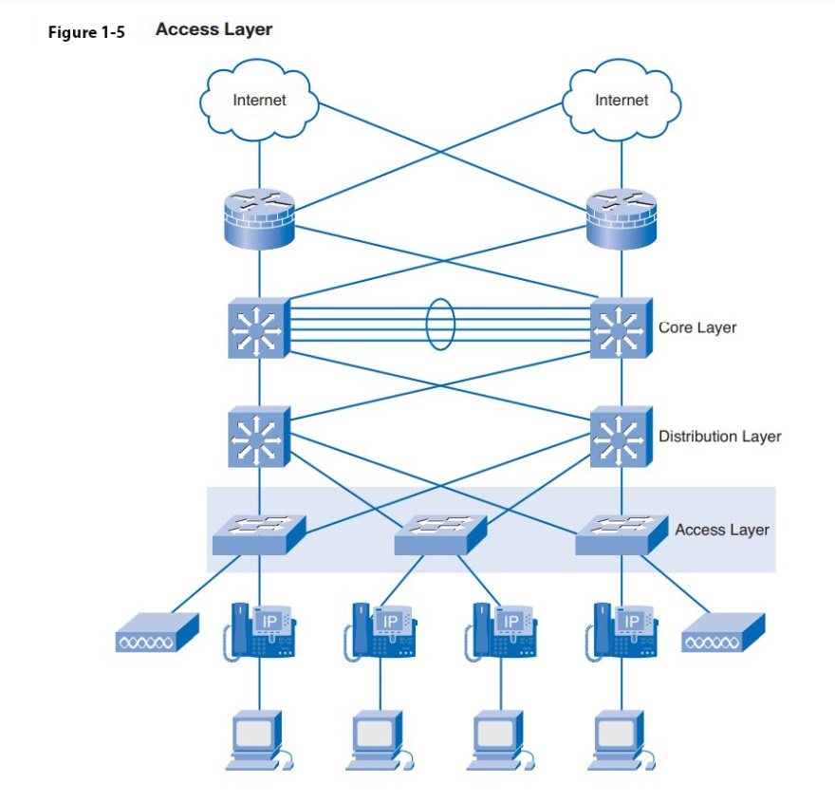
The access layer, as illustrated in Figure 1-5, represents the edge of the network where end devices connect. Access layer services and devices reside inside each building of a campus, each remote site and server farm, and at the enterprise edge.

Slide 20
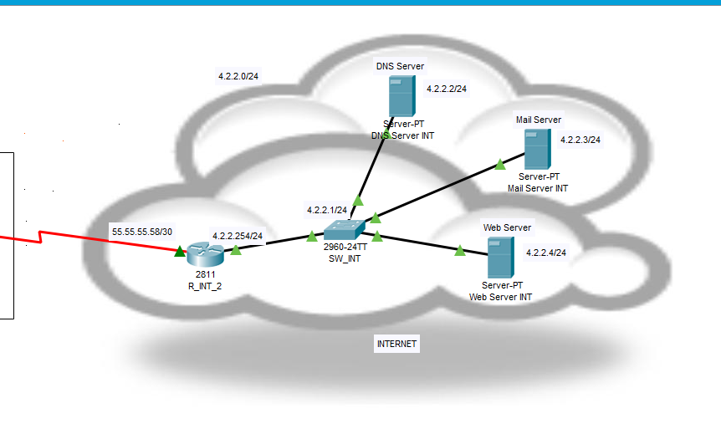
Our System Design Infrastructure

Slide 21
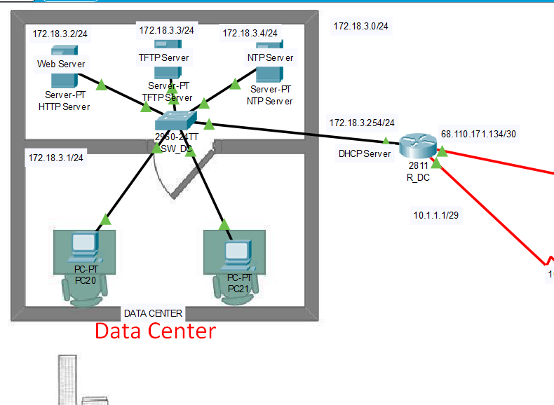
Data Center

Slide 22
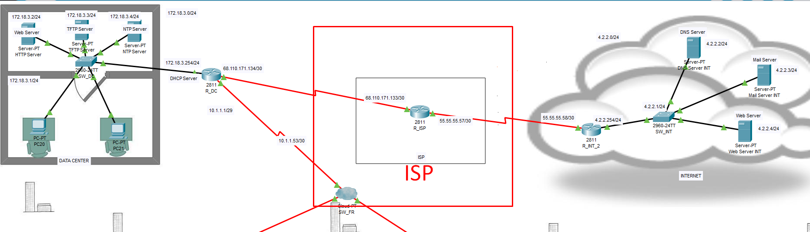
ISP (Internet Service Provider)

Slide 23
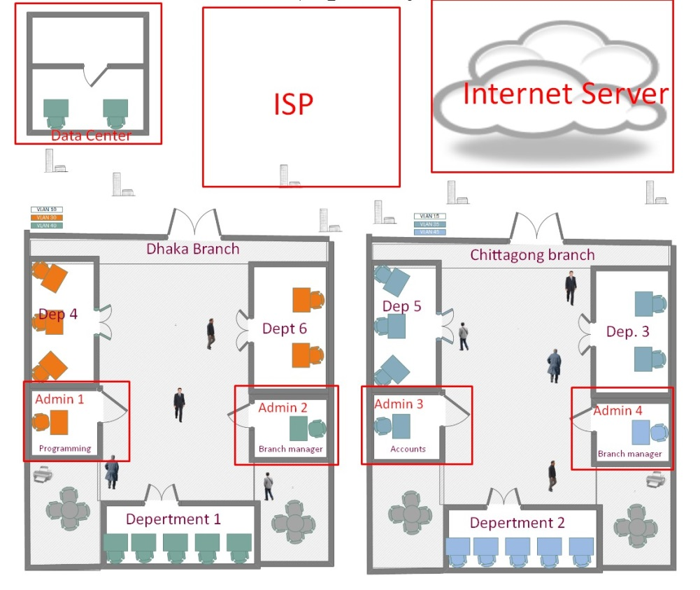
Full Environment

Slide 24
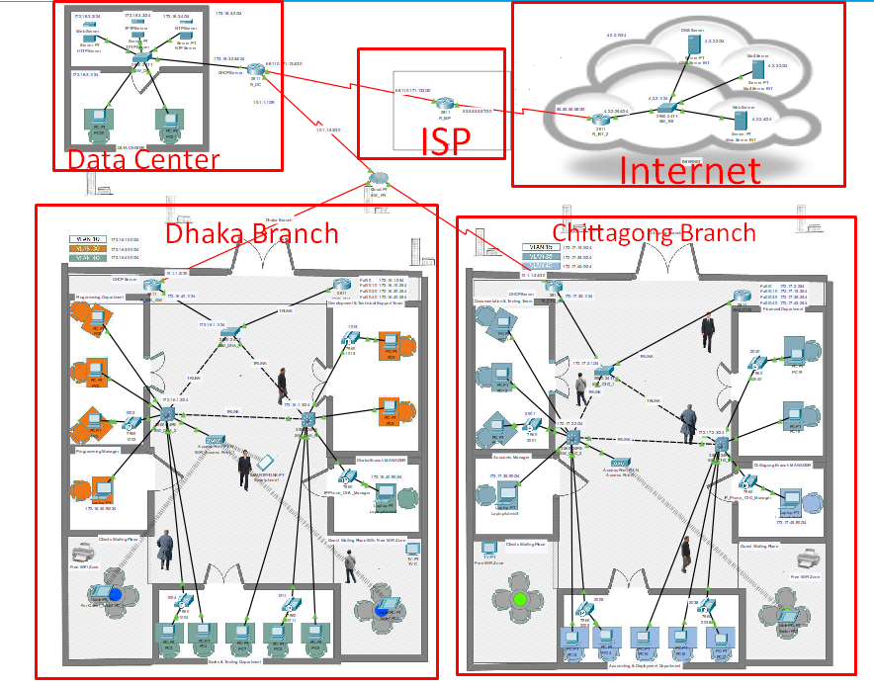

Slide 25
Required Tools
Cisco 2811 Routers
Cisco Server-PT Servers
Cisco 2960-24TT Series Switches
Cisco 3560-24PS Series Switches
Cisco Cloud-PT Cloud
Cisco 7960 iP-Phone
Cisco PC-PT PC
Cisco Laptop-PT Laptop
Cat6 UTP & Coper Cross over Cables
And so on.

Slide 26

THANK YOU
☺ ☺ ☺

Slide 27
LIST OF ABBREVIATIONS
NAT - NETWORK ADDRESS TRANSLATOR
DHCP - DYNAMIC HOST CONFIGURATION PROTOCOL
DNS - DOMAIN NAME SERVER
VOIP - VOICE OVER INTERNET PROTOCOL
EIGRP - ENHANCED INTERIOR GATEWAY ROUTING PROTOCOL
RIP - ROUTING INFORMATION PROTOCOL
OSPF - OPEN SHORTEST PATH FIRST
BGP - BORDER GATEWAY PROTOCOL
OSI - OPEN SYSTEMS INTERCONNECTION
SISO - INTERNATIONAL STANDARDS OF ORGANIZATION
CPU - CENTRAL PROCESSING UNIT
WI-FI - WIRELESS FIDELITY
VPN- VIRTUAL PRIVATE NETWORK
CIDR - CLASSLESS INTER DOMAIN ROUTING
VLSM – VARIABLE LENGTH SUBNET MASKING
ACL - ACCESS CONTROL LISTS
NIC – NETWORK INTERFACE CARD
VLAN – VIRTUAL LOCAL AREA NETWORK
LAN – LOCAL AREA NETWORK
WLAN - WIRELESS LOCAL AREA NETWORK
CLI – COMMAND LINE INTERFACE
VPN- Vertual Privet Network
TTL – TIME TO LEAVE
HTML – HYPER TEXT MARKUP LANGUAGE
DOD - DEPARTMENT OF DEFENSE

